Slide 1
Team PRINT
Rohith Chintala, Brendan Cutick, Tyler Han, Elizabeth Myers, Eric Oh, Aidan Sandman-Long, Cynthia Sheng, Nathan Spicer-Davis, Kenji Tsukamoto
Notes:
3 sec

Slide 2
Introduction
In Situ Conformal 3d Printing For Targeted Repairs
Notes:
~ 5 s

Slide 3

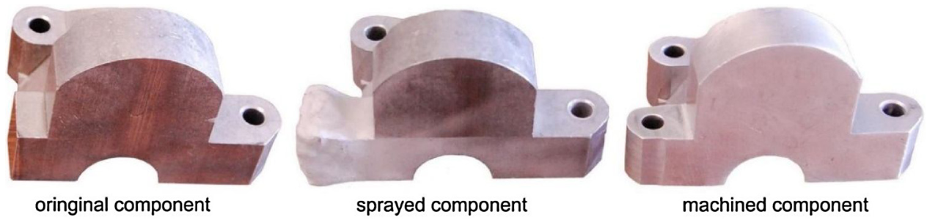
3D Printed Repairs
Advantages of Additive Manufacturing (AM) and 3D Printing
Precise material deposition
Create complex geometric shapes
Quick prototyping
Applications to medical implants
Existing Methods
Direct energy deposition
Cold spray
Sealant being used to repair pavement cracks
[1]
Cold spray repair. Material is added then machined away for precision.
[2]
Notes:
One of the reasons why 3D printing has been so successful is the technology’s ability to place material precisely into the desired locations to create more complex geometries. There are also direct applications for AM in medical implantations where subtractive procedures clearly would not be permitted. Naturally, the question of whether or not you can use this ability to repair objects in general arises. In the same way roads are repaired by adding sealant, more complex geometric shapes can be repaired by building or reinforcing 3D prints.

Slide 4
Research Problem
Notes:
Moving onto our research problem. What is the specific area of reparative 3D printing we would like to address?

Slide 5
How effective is repairing 3D printed structures with conformal 3D printing?
Notes:
We define Effective to mean an assessment of how strong or material efficient a conformal repair is. This can be done quantitatively by comparing ultimate stresses, stress-to-weight ratios, or qualitatively by assessing how and where the repaired structure breaks as opposed to a non-repaired structure.

Slide 6
Our Research Focus
Conformal Printing literature dates back <10 years
Existing work lacks structural analysis
Provide analysis and data for reparative prints while varying various features:
infill %
repair-damage interfaces
repair/bed material
infill pattern
Notes:
Reviewing literature and current work, we’ve found that projects conducted in this area date at most 10 years prior. And most (if not all) of that work is done in the 3D scanning and path planning algorithm development aspects of the problem.
After a review of relevant literature and existing work done in the area of conformal 3D printing and reparative printing, we’ve found that most of the work dates no later than 10 years back. The field is relatively new and the aspects of the problem that have been researched so far are related mainly to path planning algorithms, 3D scanning and processing, and robotic printer design. However, in order to use these reparative technologies, it’s imperative that there is data and structural analysis on the repaired parts and materials themselves to understand where and how printed repairs might be appropriate in terms of structural strength or efficiency.
In our work, we plan to provide further data and analysis for these reparative prints while conducting experiments with infill percentage, repair interfaces, repair and bed materials, and/or infill patterns.

Slide 7
Current Status

Slide 8
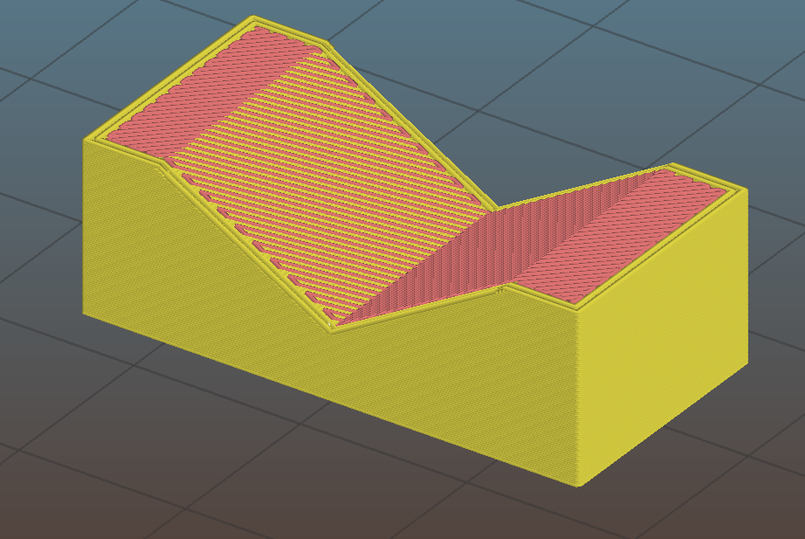
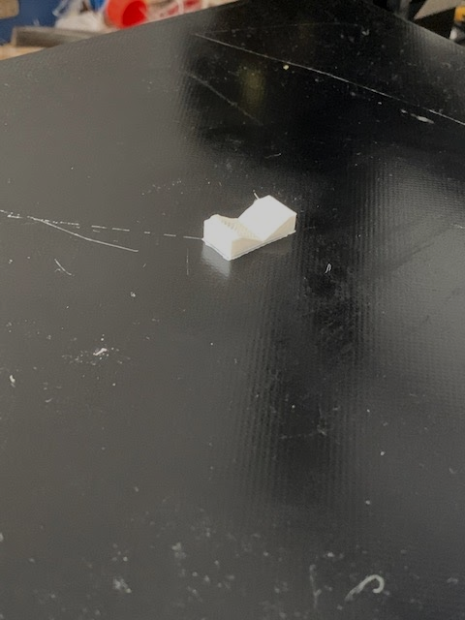
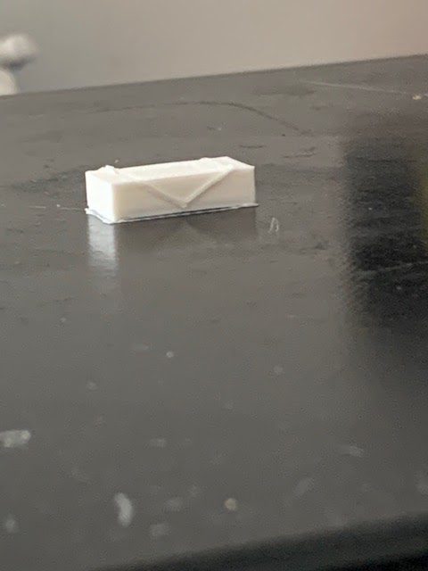
Slicing
Used to generate code to run 3d printer
Using modified Slic3r software
To simulate damage, pieces are sliced in two parts
Bottom Part represents damaged component
Top part represents the “repair”
Slicing
“Damaged” Print
Repaired
Print
Notes:
(with known geometry)
(filling)

Slide 9
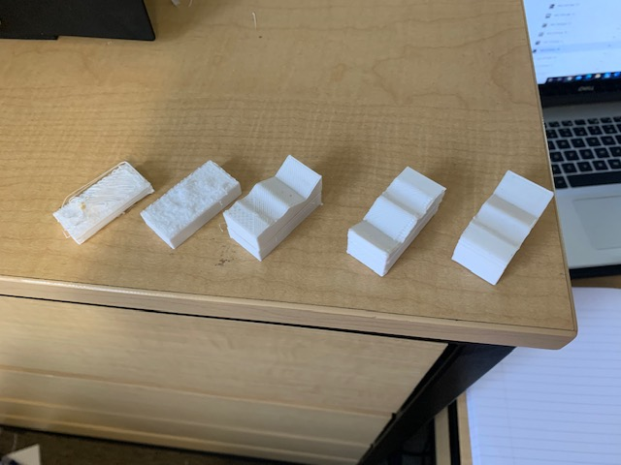
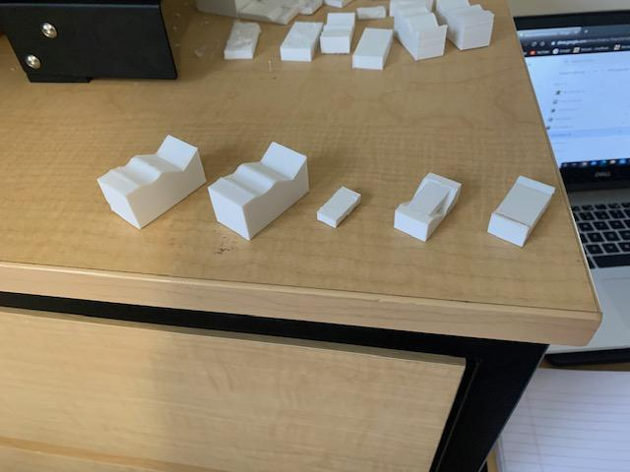
Progression of prints
We have experimented with a multitude of different variables on our way to a successful in situ conformal print
To large layer
Height (.2 mm, 20% infill) part 1
To large layer
Height (.2 mm, 20% infill) part 2
To large layer
Height (.16 mm, 20% infill)
Belt became unstable (.12 mm, 20% infill)
Perfect (.12 mm, 20% infill)
Corner raised (fixed by closing window and using hairspray) (.12 mm, 100% infill)
Perfect (.12 mm, 100% infill)
Insitu conformal print, T1 small (.12 mm, 100% infill)
Insitu conformal print, T1 big (.12 mm, 100% infill)
Insitu conformal print, T3 big (.12 mm, 100% infill)
Notes:
Aidan

Slide 10
Methodology
Notes:
The following is our methodology for testing our prints.

Slide 11
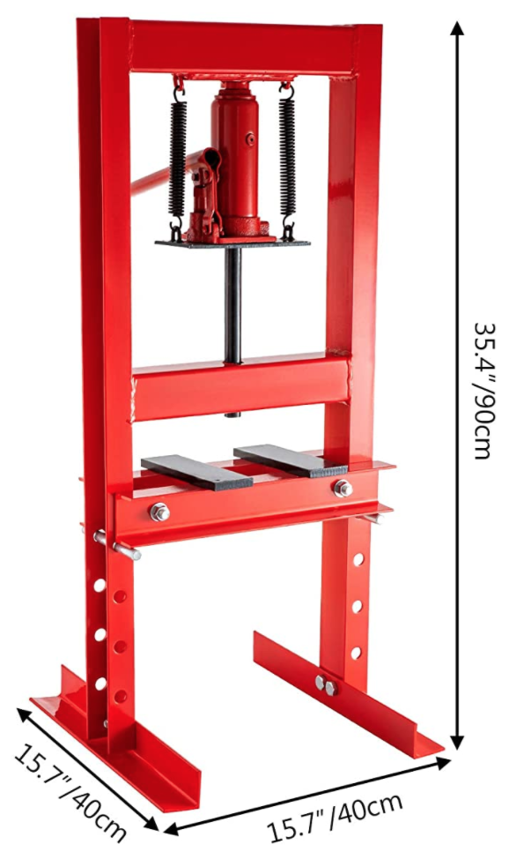
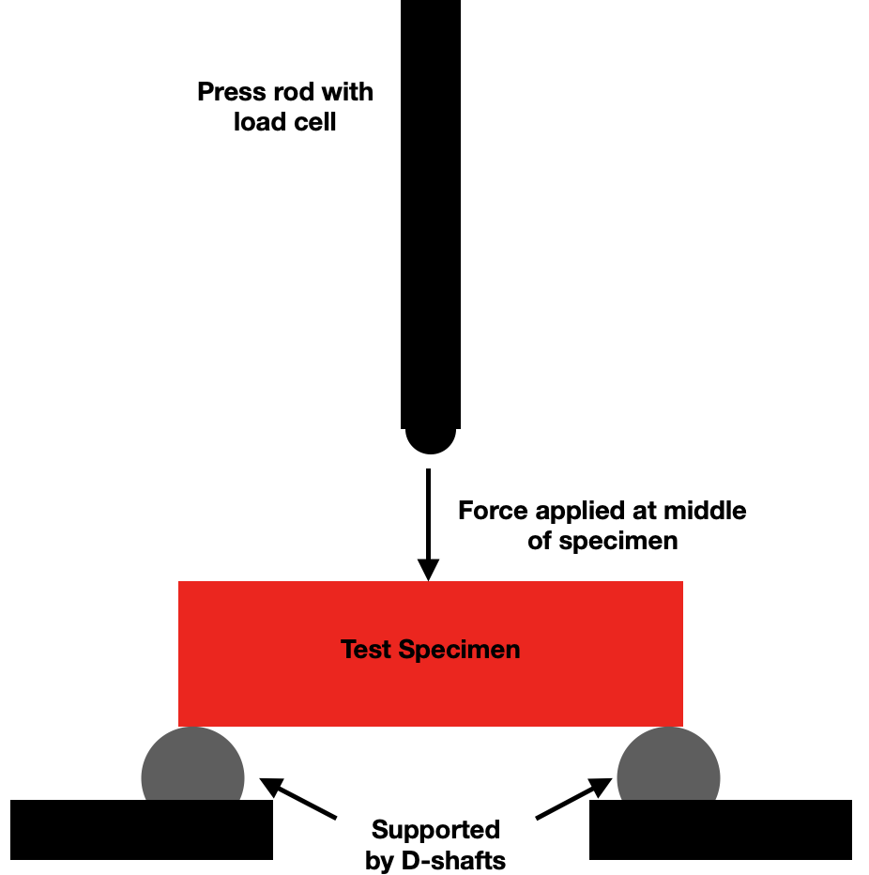
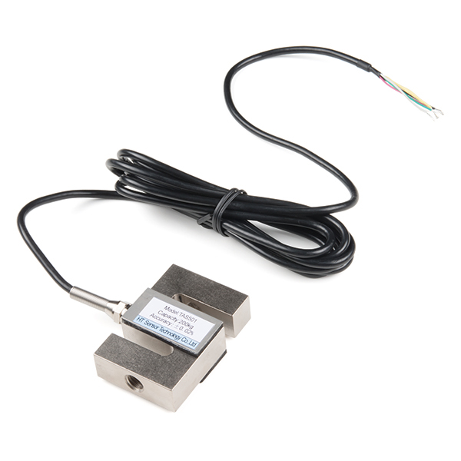
Testing Setup
Lost access to campus testing laboratories
3 Point Bend Test (ASTM D790)
Strain Gauge
Load Cell
Arduino Uno used for measurements and output
[3]
Sketch of test setup
[4]
Notes:
D790 (3 Point Bend Test) used commonly for 3D printed PLA Testing
Clean part with alcohol and attach strain gauge on bottom directly under loading point
Instrument used to measure the strain on an object
Place part onto the press where it will be supported by the D shaft on either ends and secured using glue and clamps
Load cell attached onto the press to measure the total force put onto the part
Arduino Uno is attached to the strain gauge and load cell to monitor the strain and force
Hand Press → press rate will be monitored through the readings of the strain, force, and/or displacement rate as it is pressed
Use ruler to record displacement
Recorded data → stress/strain curves, determine strength-to-weight ratios, create force vs. displacement graphs.

Slide 12
Experimentation
Infill Testing | Damage Testing
Testing parts at multiple % infills Analysis of the best balance of repeatability with print time Used to determine infill for damage testing | Testing Control, Repaired and Unrepaired parts Analysis of the effects of repairs on ultimate strength of parts
48 Samples | 78 Samples
Notes:
Talk about how this is just initial avenues of testing
For each test, 6 samples will be printed to account for mistakes in testing.
These tests will be used to compare the ultimate stress of the parts from the stress strain graphs generated by the arduino for the 3 point bend test. The goal of this will be to compare the ultimate stress of these parts with the time it takes to print. This will allow us to see at what point there is diminishing returns to find the optimized infill that will have the best balance of print time with strength. This test will also allow us to see whether the infill's effects on strength are differ between the solid control parts and the conformal printed repairs.
Using the results from the infill testing, for damage testing the parts will be printed at the infill with the best balance between strength and time.
These tests will be used to compare the strength of the parts through the stress strain graphs generated from the arduino from the 3 point bend test. The ultimate stress of these geometries at the infill found from infill testing will be compared to the control. The control will give the upper bound of the ultimate strength while the unrepaired parts will give the lower bound allowing for accurate comparison of the efficacy of the repaired parts. This comparison will give information on how effective conformal repairs are for each geometry and whether conformal repairs in general can be comparable to the ultimate stress of a control part.
In total 126 parts will be printed in PLA for these 2 tests
Given the speed of initial PLA tests, further testing using carbon fiber composites or other 3D printed materials may be used to further test stronger materials.
Another avenue of research that can be done time permitting is testing the difference in repair efficacy between conformal repairs using nonplanar printing and repairs using steps.

Slide 13

Moving Forward: Goals & Project Timeline
Notes:
After some setbacks resulting from COVID-19, we have recreated our project timeline and have been completing our main milestones on schedule. We are fully prepared to move on with data collection in the remaining weeks and semesters.

Slide 14
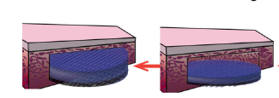
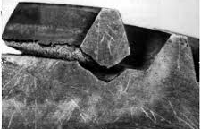
How We Will Do Good
Applications in the healthcare industry
3D printing can be used to repair bone defects
Used to print scaffolds for bone and tissue regeneration [5]
Applications in education and public relations
Conformal printing can be used for student experiments and educating the public
Applications in the space and defense industry
Satellite servicing and extraterrestrial rover repair
Can repair damaged gears, brackets, and small parts
3D printed scaffold inserted into bone defect
[5]
Common damage to gears
Notes:
In addition to our current research, there are many potential future applications for conformal 3D printing that would benefit our society. In the healthcare industry, biomedical engineers are developing methods of printing scaffolds that are used to repair bone defects, but for now they are limited to defects of relatively simple shapes, as shown in the image on the bottom left. Our conformal printing methods can be used to broaden the types of bone defects that can be successfully repaired with these scaffolds. In the field of education, conformal printing can be used to educate students studying CAD and 3D printing. Further down the line, potential applications in the space industry include repairing small parts and fixing damage done to extraterrestrial rovers.

Slide 15
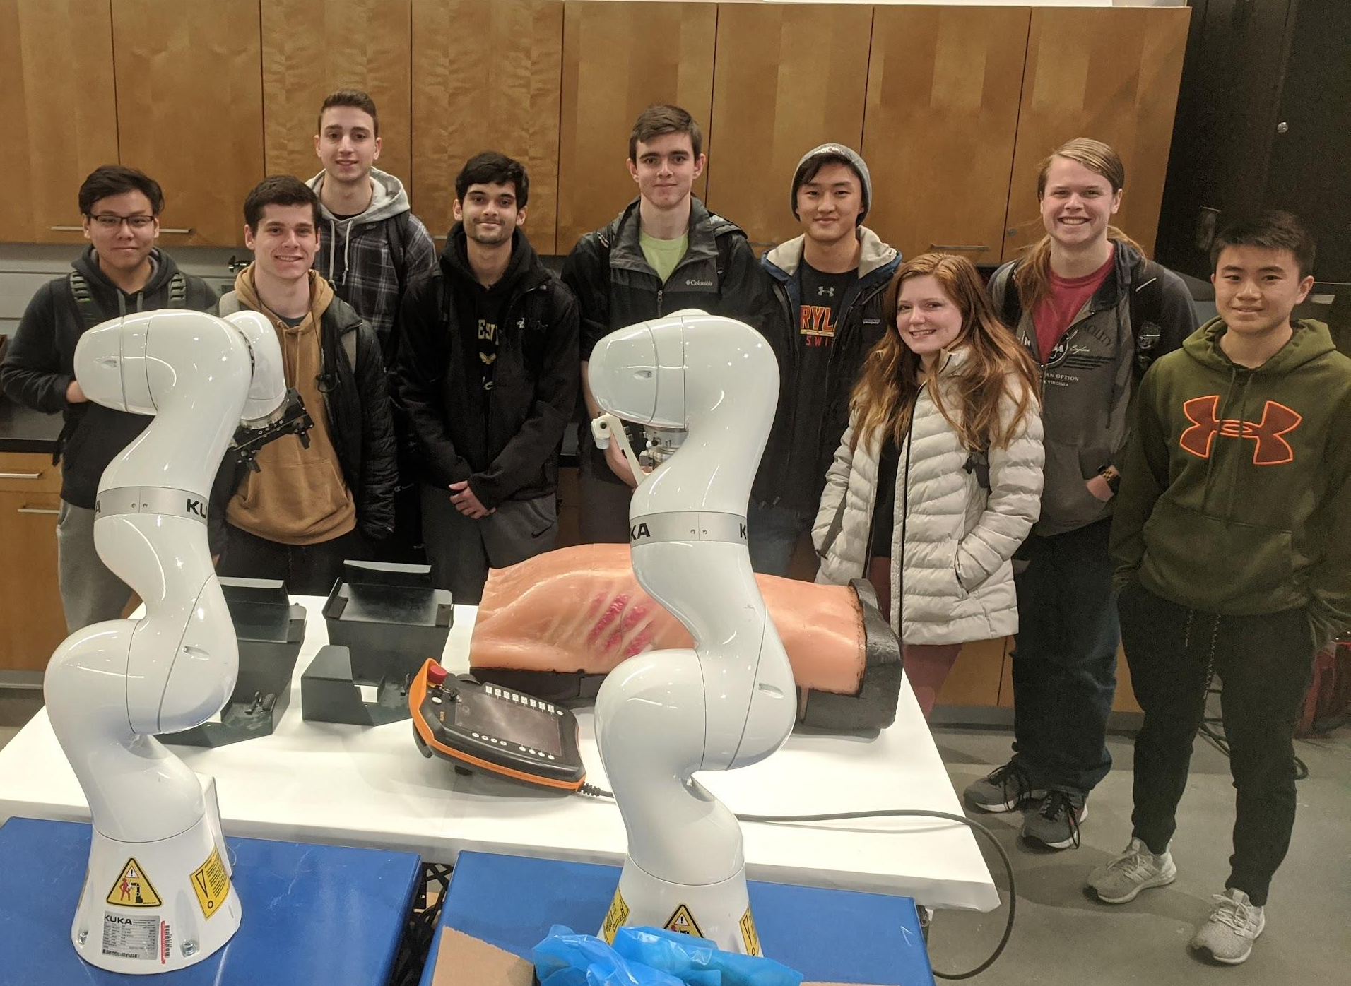
Conclusion
Defined main research contributions
Created a feasible timeline for the future
Completed important milestones
Preparing for data collection and analysis
Despite COVID-19 setbacks we are moving forward!
Notes:
Kenji - basically read this off

Slide 16
Citations
[1] “How to Crack Seal Right, Step By Step,” AsphaltPro Magazine. https://theasphaltpro.com/articles/crack-seal-right-step-step/ (accessed Oct. 27, 2020).
[2] S. Yin et al., “Cold spray additive manufacturing and repair: Fundamentals and applications,” Additive Manufacturing, vol. 21, pp. 628–650, May 2018, doi: 10.1016/j.addma.2018.04.017.
[3] “Amazon.com: Mophorn Hydraulic Shop Press 6 Ton H-Frame Hydraulic Press 13227lbs with Heavy Duty Steel Plates: Home Improvement.” https://www.amazon.com/dp/B07WQVX5B1/ (accessed Oct. 29, 2020).
[4] “Load Cell - 200kg, S-Type (TAS501) - SEN-14282 - SparkFun Electronics.” https://www.sparkfun.com/products/14282 (accessed Oct. 29, 2020).
[5] L. Zhang, B. N. Johnson, and G. Yang, “Three-dimensional (3D) printed scaffold and material selection for bone repair,” Acta Materialia , 2018.
[6] “Student Experiments Launched to the ISS on NG-10,” Space Station Explorers, Nov. 23, 2018. https://www.spacestationexplorers.org/student-experiments-launched-on-ng-10/ (accessed Oct. 29, 2020).
[7] “Failure Modes in Gears. Causes of Failure of Gears. Gears Failure.” Bright Hub Engineering, 24 Sept. 2008, www.brighthubengineering.com/cad-autocad-reviews-tips/8443-failure-modes-in-gear-part-one/.

